Slide 1
Master Thesis
Electric Engine Modelling

Slide 2
Objective
To predict 2D and 3D KPIs : Mgrenz(Torque Curve) and ETA(Efficiency Grid) plots for topology invariant IPSM Electric Motors designs.
Regression Problem

Slide 3
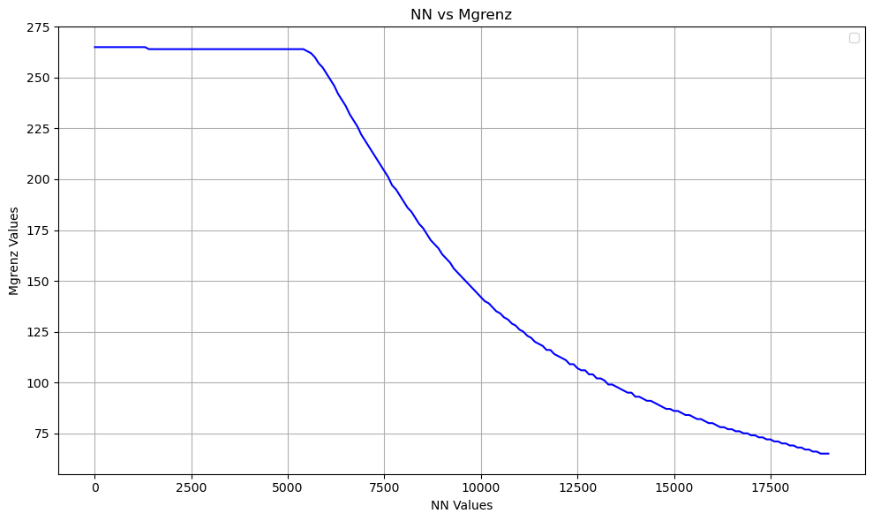
Mgrenz KPI - 2d Plot

Slide 4
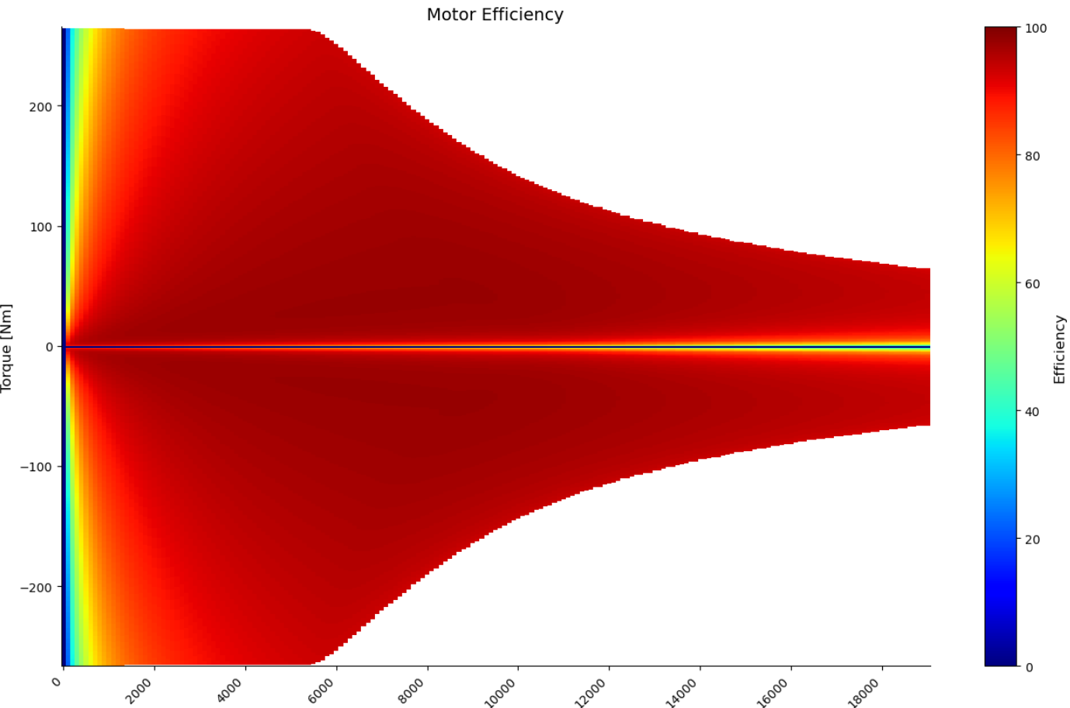
ETA KPI - 3d Plot

Slide 5
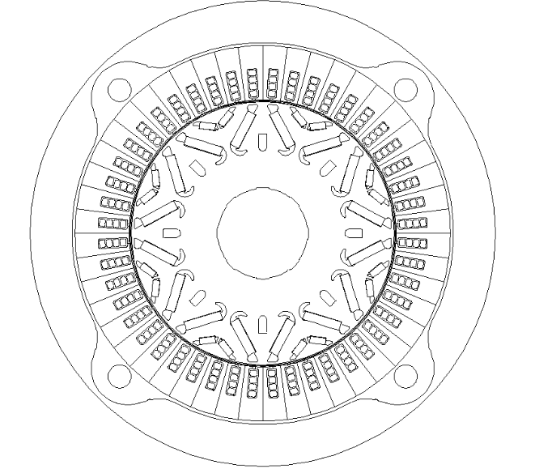
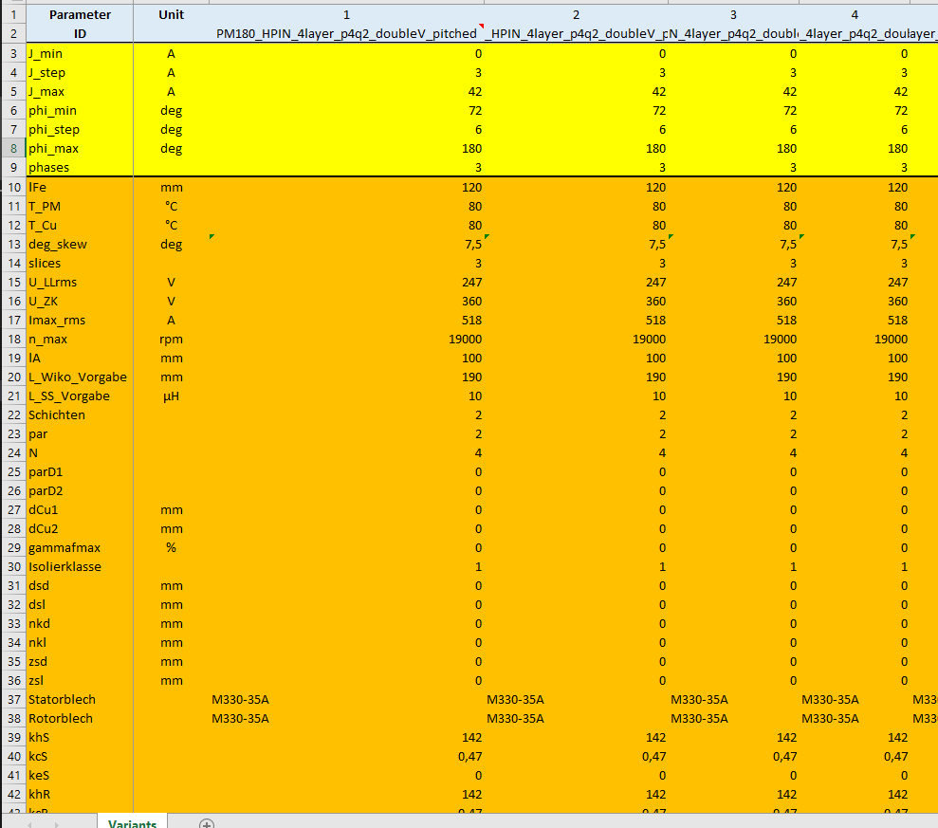
Dataset
Valeo provided ~1500 Double V magnet parametric description

Slide 6
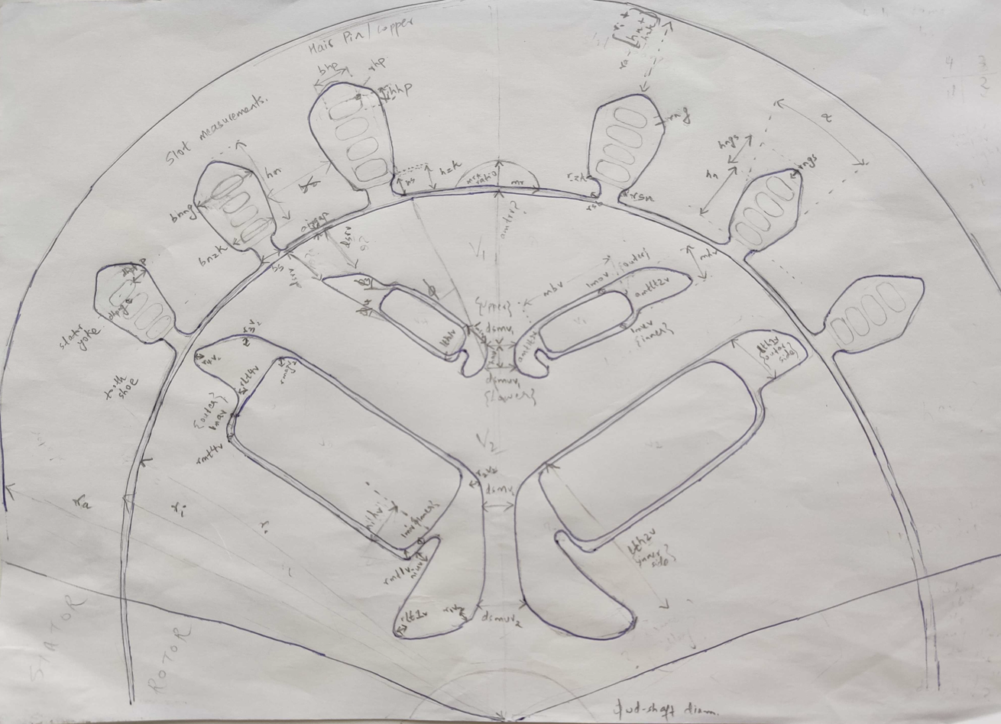
Electric Motor Cross-section

Slide 7
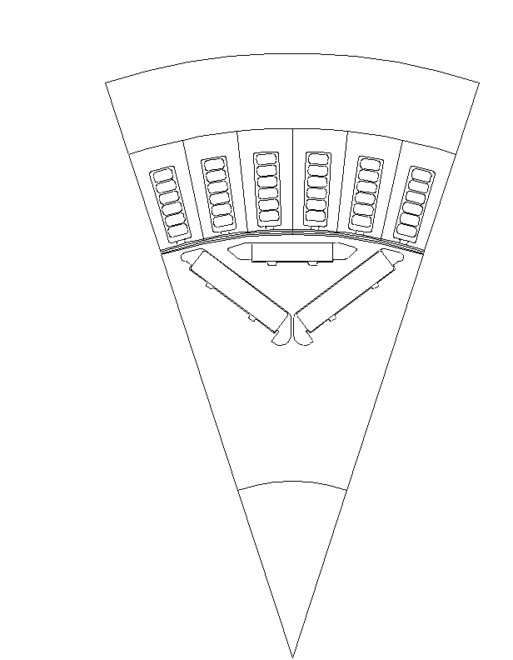
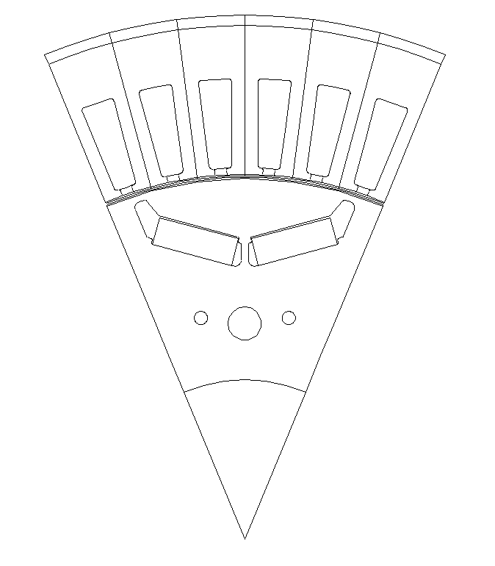
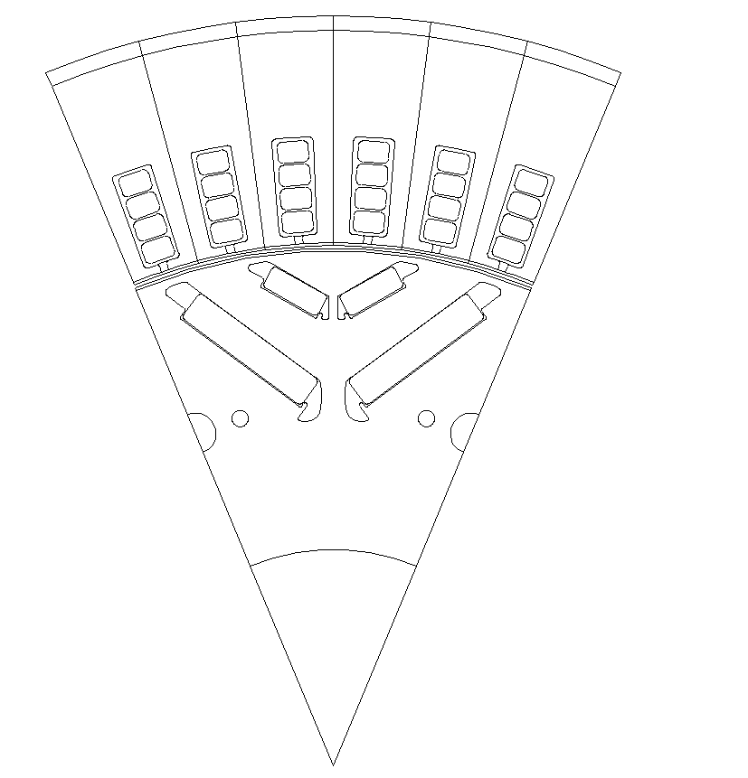
EM Topologies Manufactured by Valeo
Nabla Magnet
Double V Magnet
Single V Magnet

Slide 8
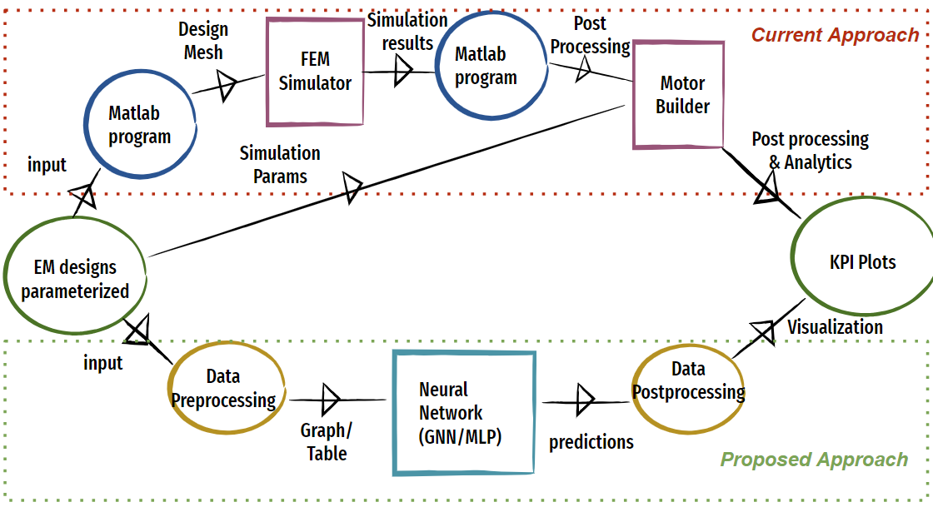
Process Flowchart

Slide 9
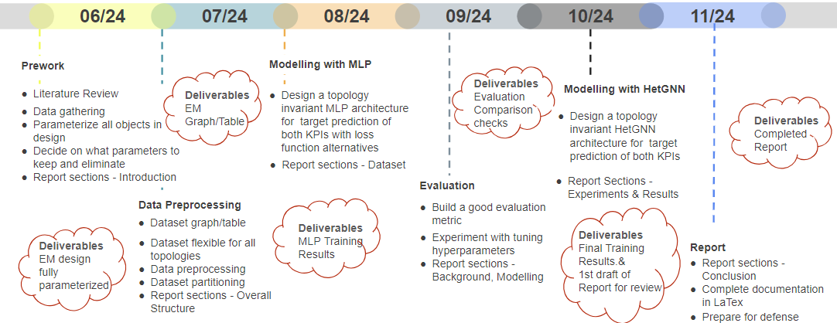
Proposed Timeline

Slide 10
1st Approach

Slide 11
Tabular Representation
Using MLP model
Topology invariance achieved with distinct columns
Geometric connections not explicit
Multiple slots/Magnets/Windings are represented by count as columns

Slide 12
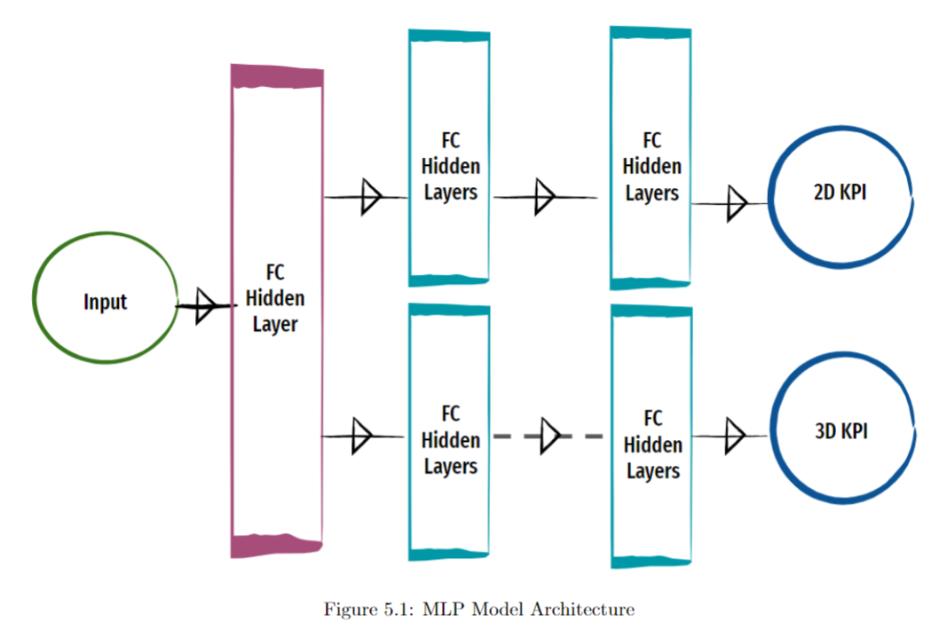
MLP Model

Slide 13
Data Preprocessing
All degree values converted to their corresponding radian values
Only Positive part of ETA grids are considered
All ETA grids padded with the max rows based on Max Mgrenz value
Cross Fold Validation used to have most data for training- 5 folds and best performing model(lowest combined loss and both outputs scores to be minimum) to be chosen for inference

Slide 14
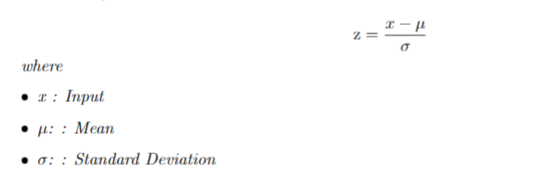
Data Preprocessing
Standard Scaler - Input features

Slide 15
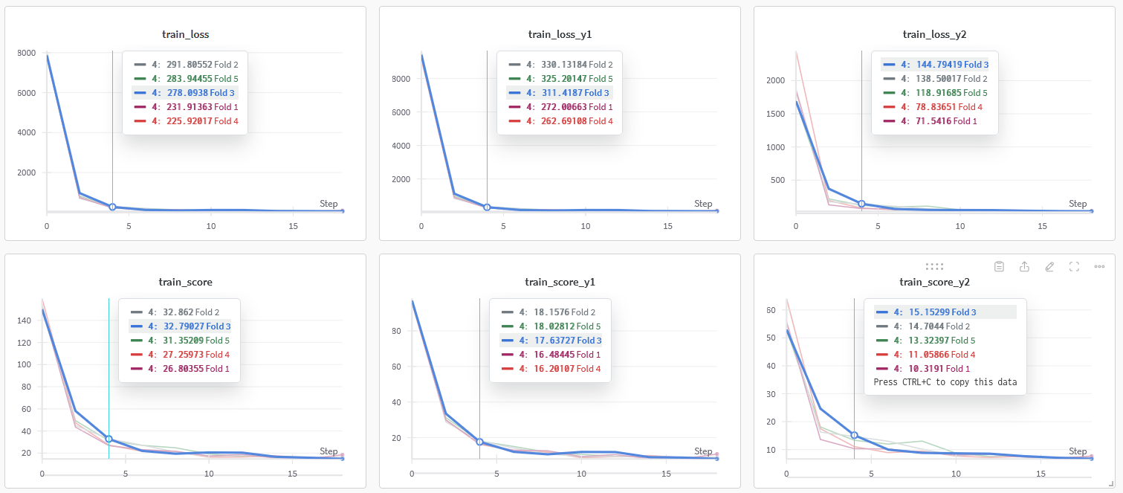
MLP Training Plots

Slide 16
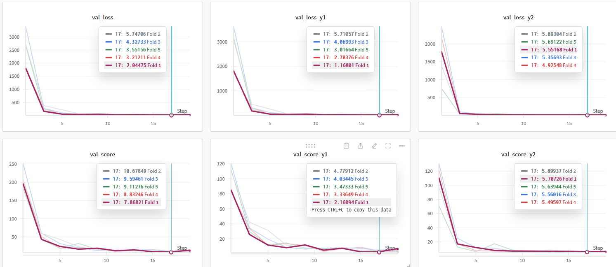
MLP Validation Plots

Slide 17
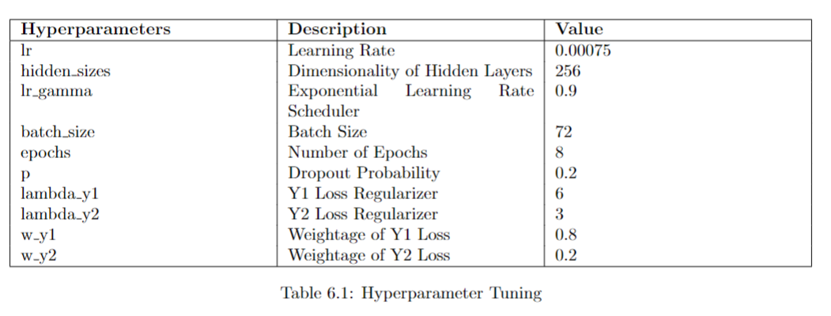
Hyperparameter Tuning

Slide 18
Loss Calculation
Loss : Mean Squared Error
Total Loss = 2D KPI Loss Weightage(2D KPI Loss Regularization + 2D KPI Loss) + 3D KPI Loss Weightage(3D KPI Loss Regularization + 3D KPI Loss)

Slide 19
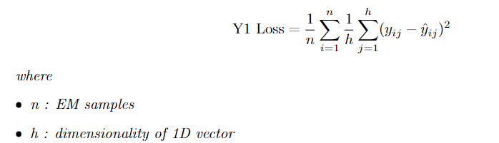
MSE Loss 2D KPI

Slide 20
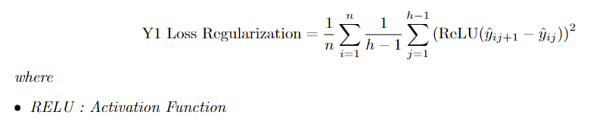
Loss Regularization for 2D KPI
Regularization : MSE Loss L2 regularized such that prediction of a specific element in the array is less than or equal to prior element
To encourage monotonically decreasing array values(as implied by torque curve)

Slide 21
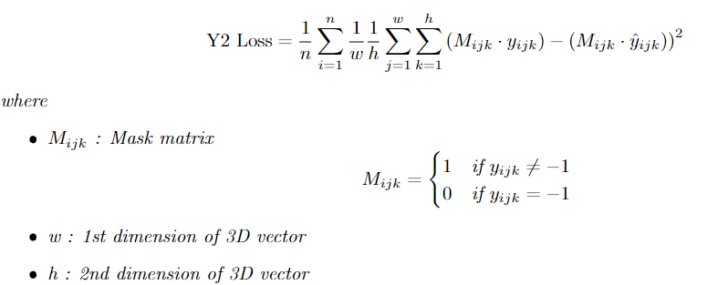
MSE Loss 3D KPI

Slide 22
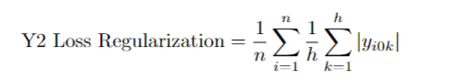
Loss Regularization for 3D KPI
The values corresponding to center row of each grid contribute to loss regularization.
Thus favoring 0’s as the efficiency at torque 0 is always 0

Slide 23
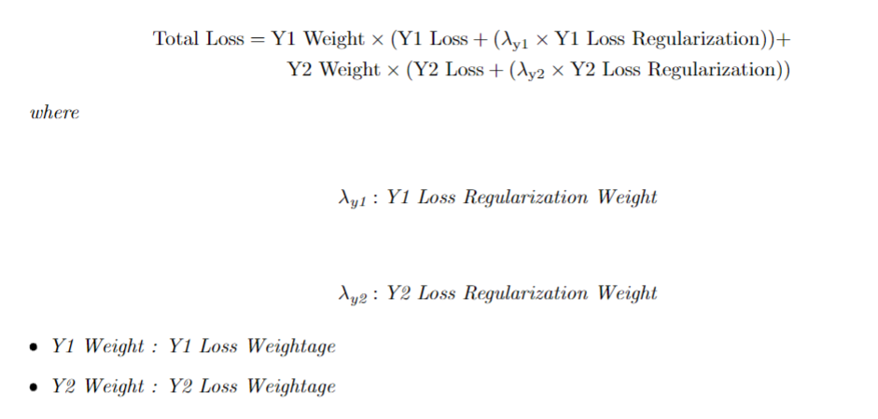
Total Loss
Total Loss = Loss calculated for 2D KPI + 3D KPI

Slide 24
Post Processing
Scale input with same scale used for training
Once ETA predictions are obtained, slice them based on shape of its corresp Torque curve

Slide 25
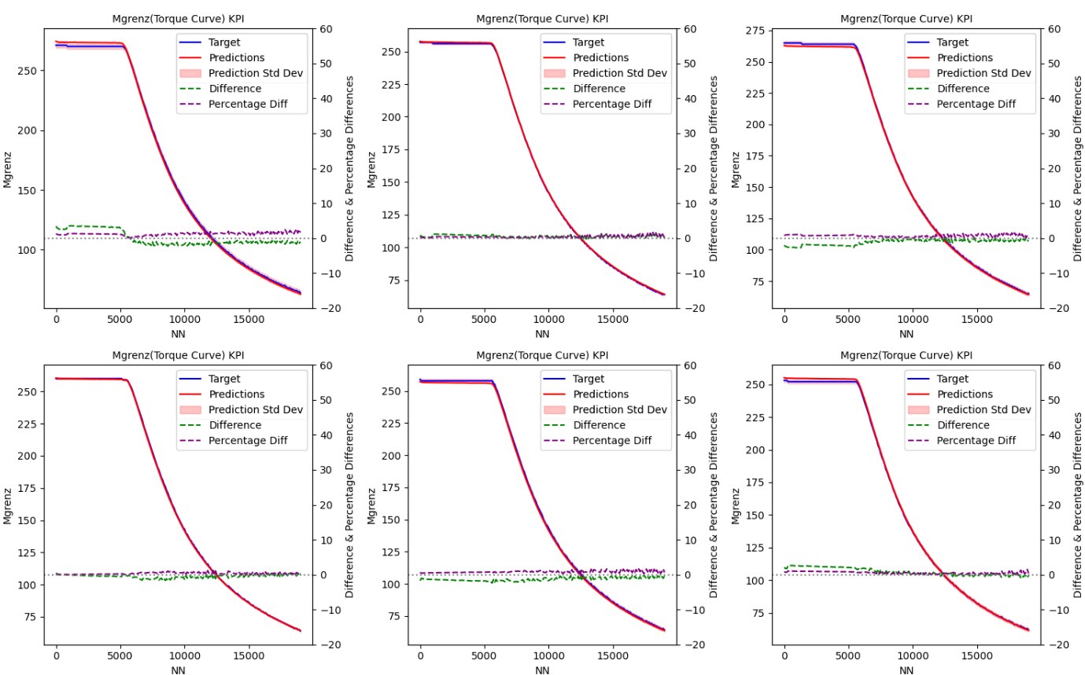
MLP Training Results for KPI prediction Mgrenz

Slide 26
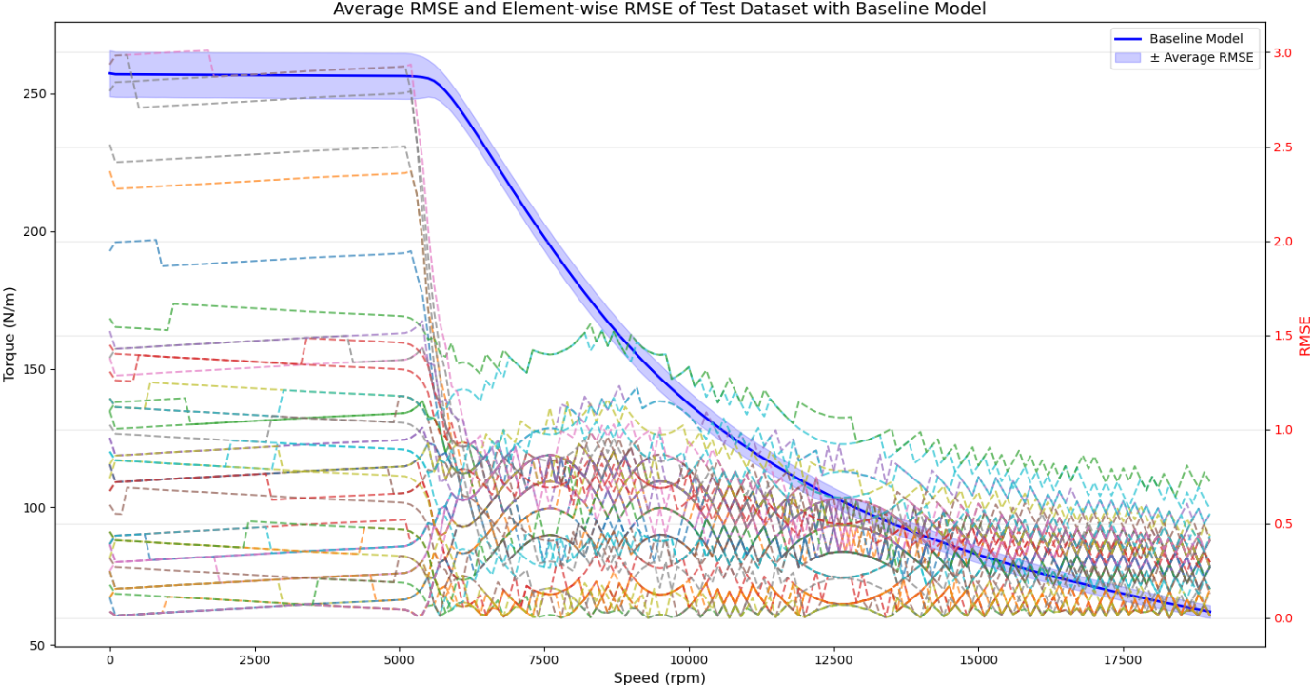
2D KPI

Slide 27
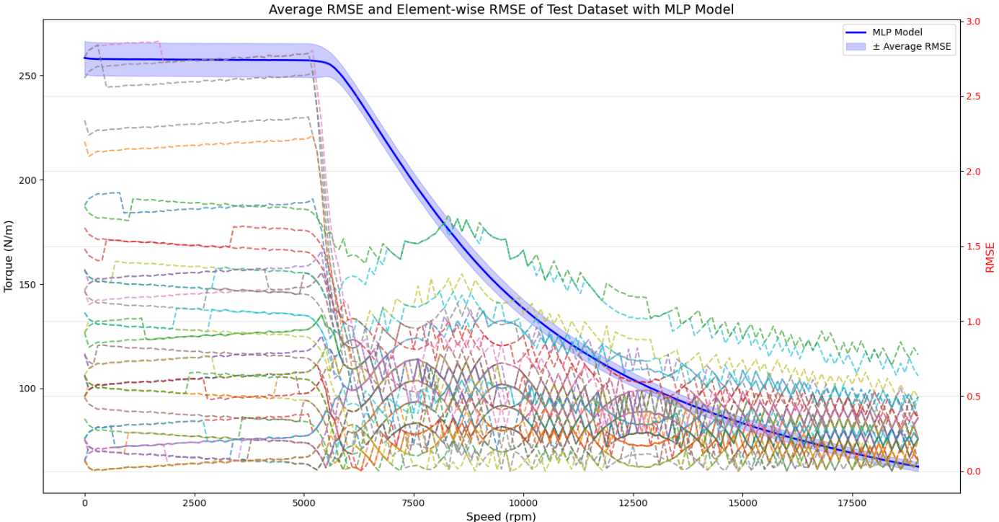
MLP Training Results for KPI prediction Mgrenz

Slide 28
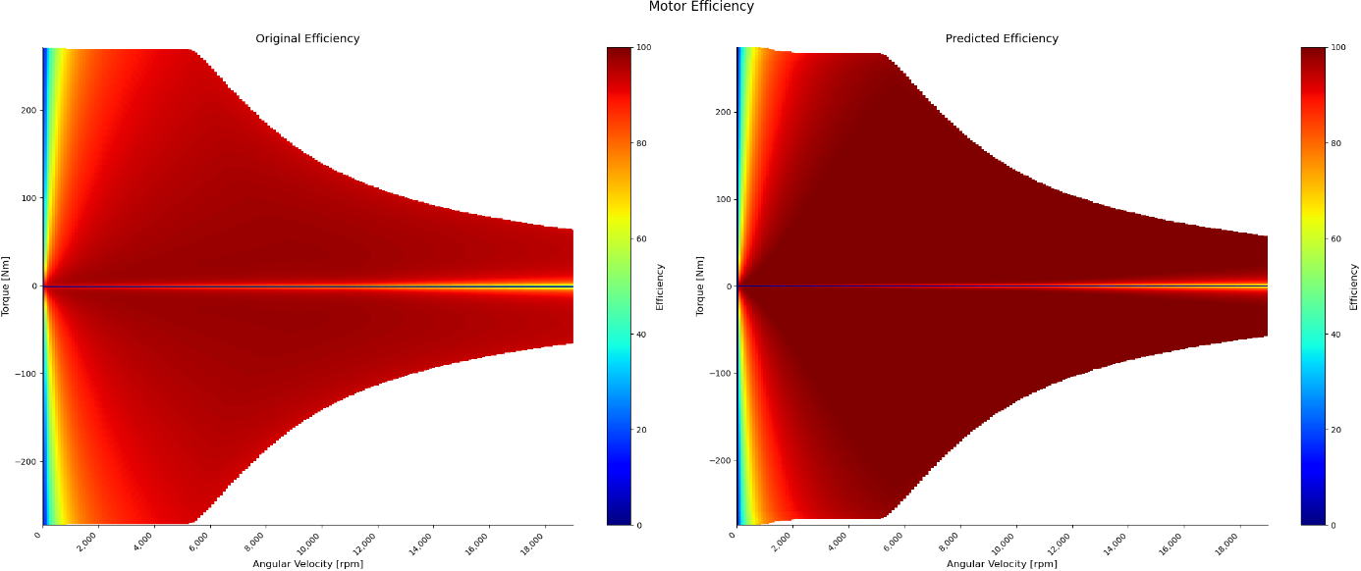
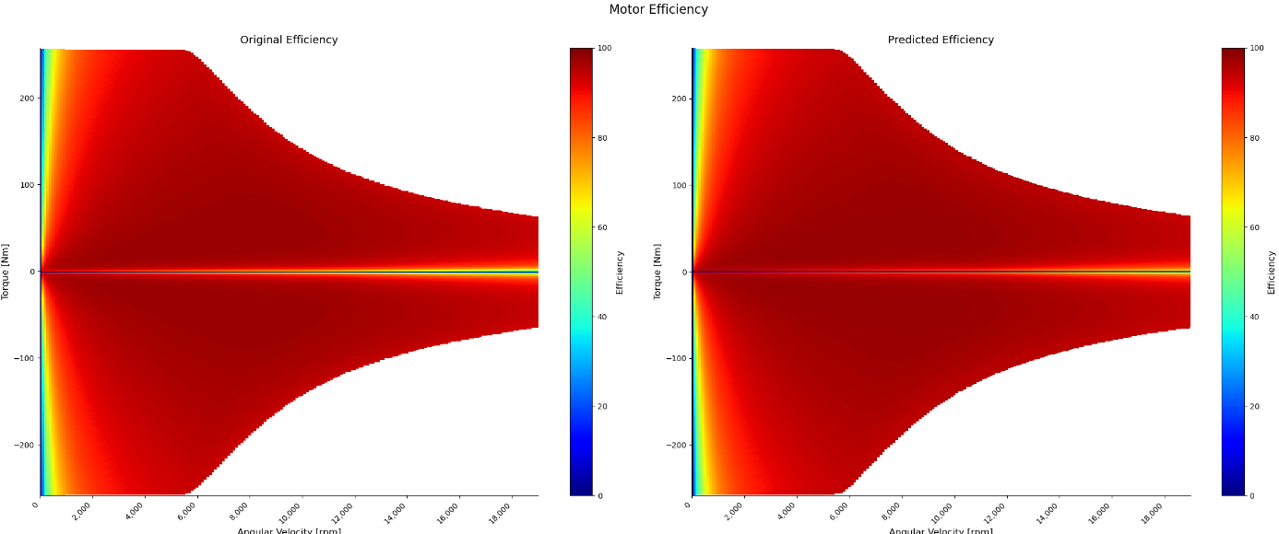
MLP Training Results for KPI prediction ETA

Slide 29
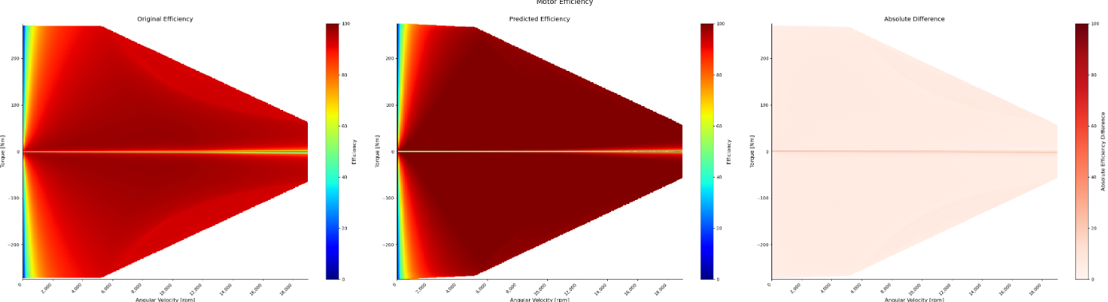
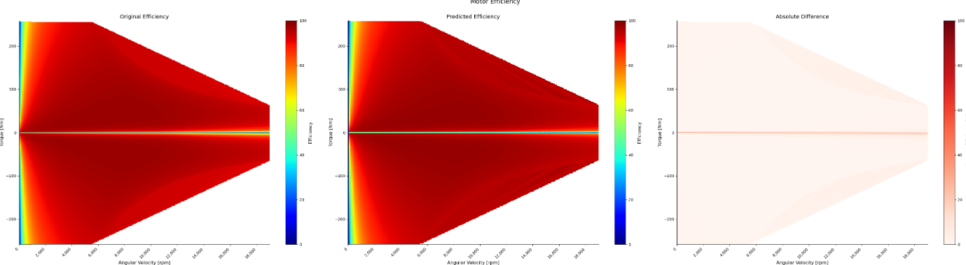
MLP Training Results for KPI prediction ETA

Slide 30
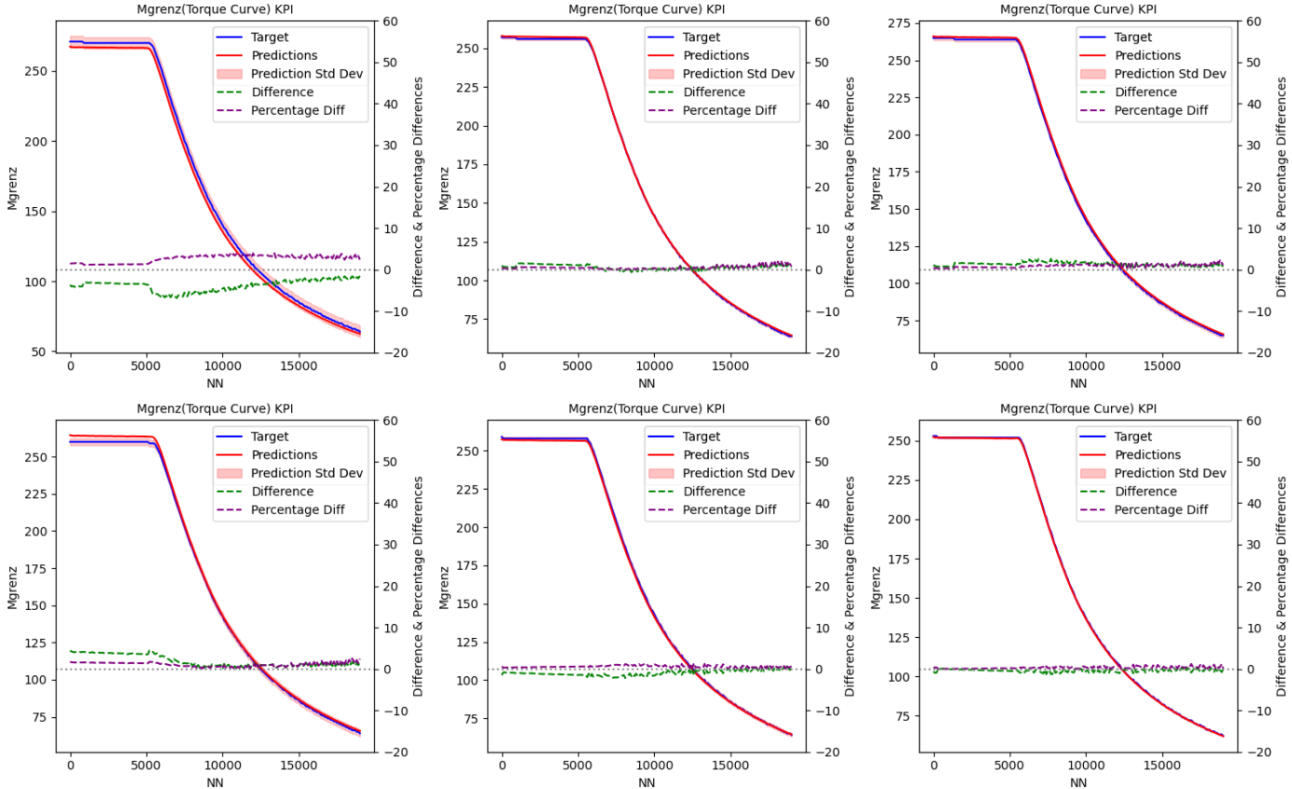
MLP* Training Results for KPI prediction Mgrenz

Slide 31
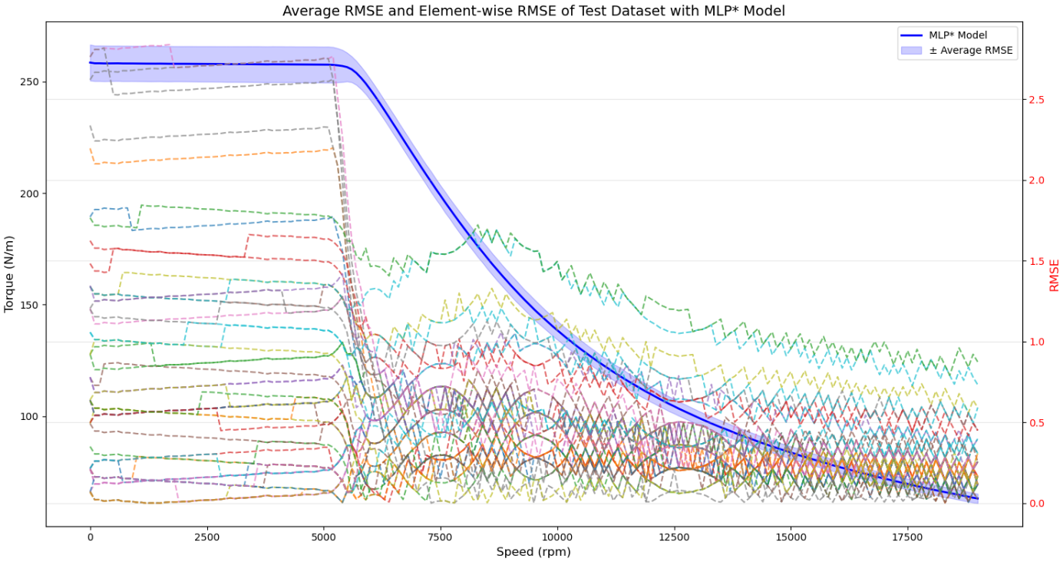
MLP* Training Results for KPI prediction Mgrenz

Slide 32
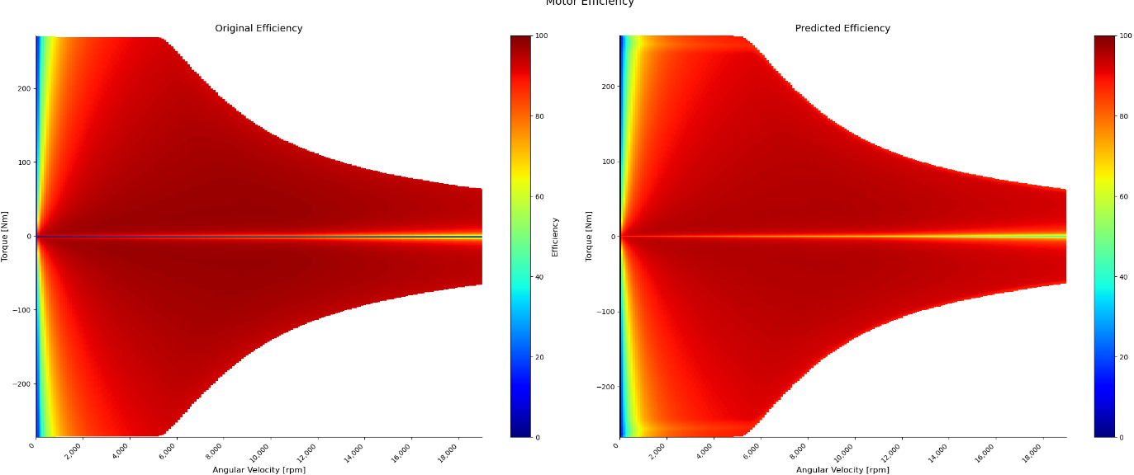
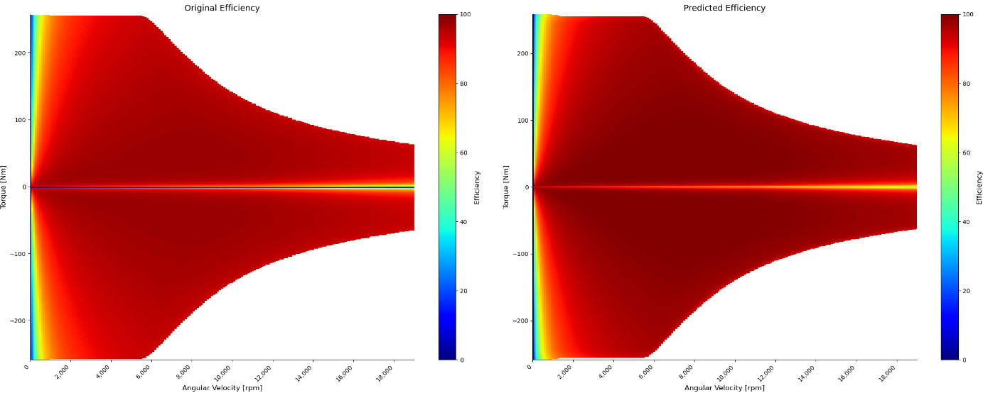
MLP* Training Results for KPI prediction ETA

Slide 33
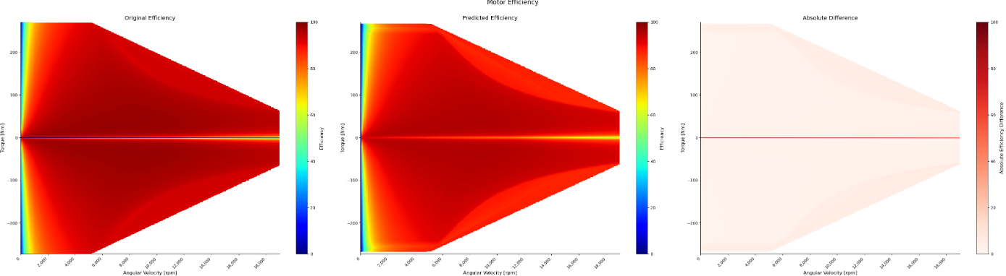
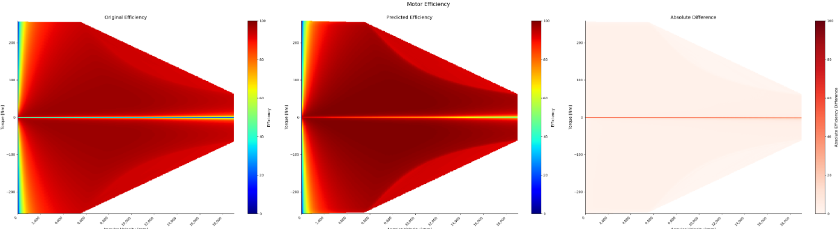
MLP* Training Results for KPI prediction ETA

Slide 34
Evaluation Metrics
RMSE as a Score for both KPIs
Difference and Percentage Difference for 2D KPI and Difference for 3D KPI

Slide 35
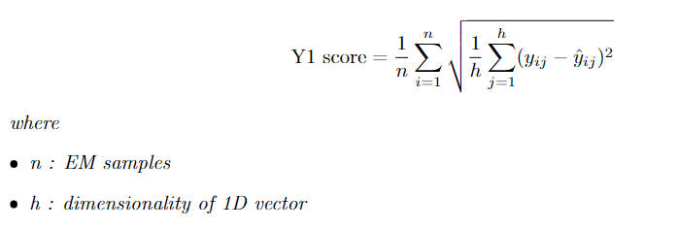
Evaluation Metric for 2D KPI

Slide 36
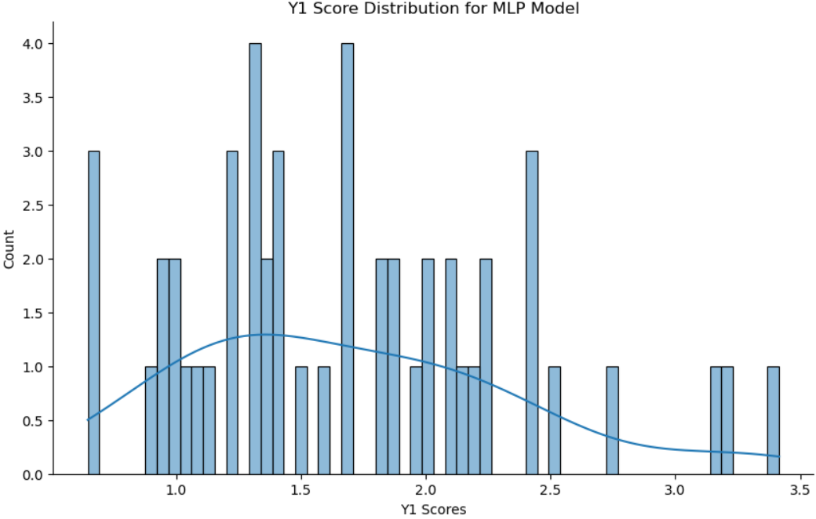
Evaluation Statistics 2D KPI

Slide 37
Evaluation Statistics 2D KPI

Slide 38
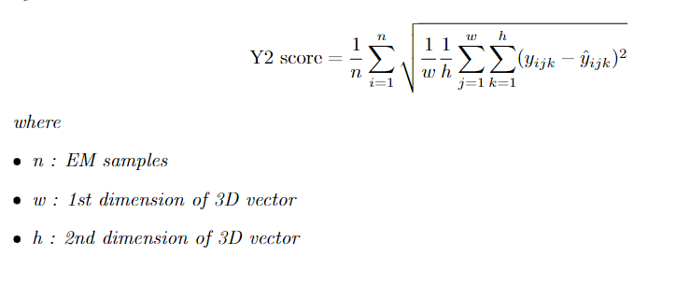
Evaluation Metric for 3D KPI

Slide 39
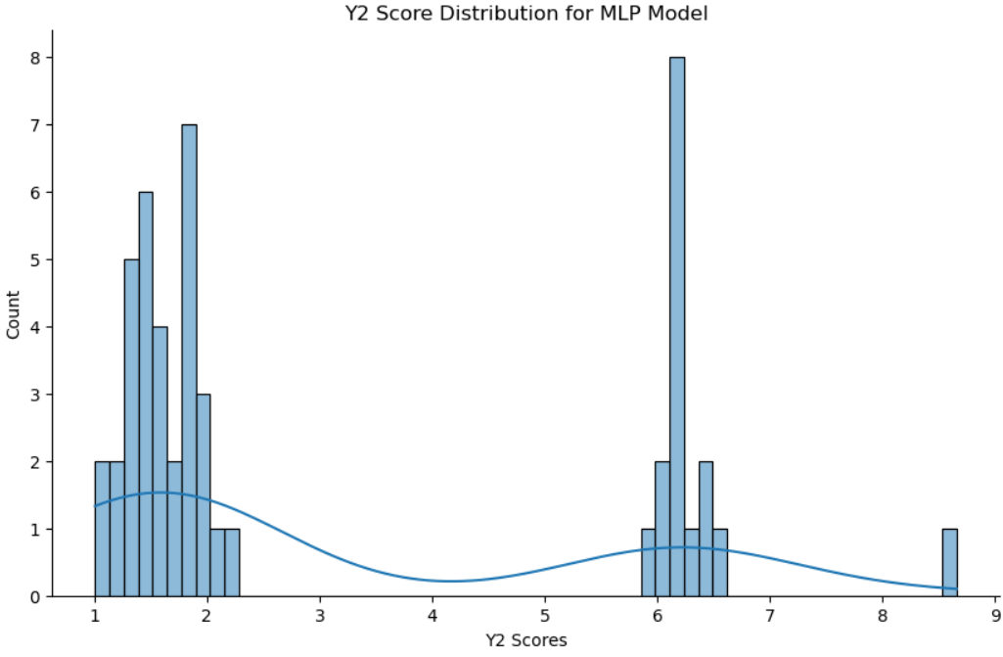
Evaluation Statistics 3D KPI

Slide 40
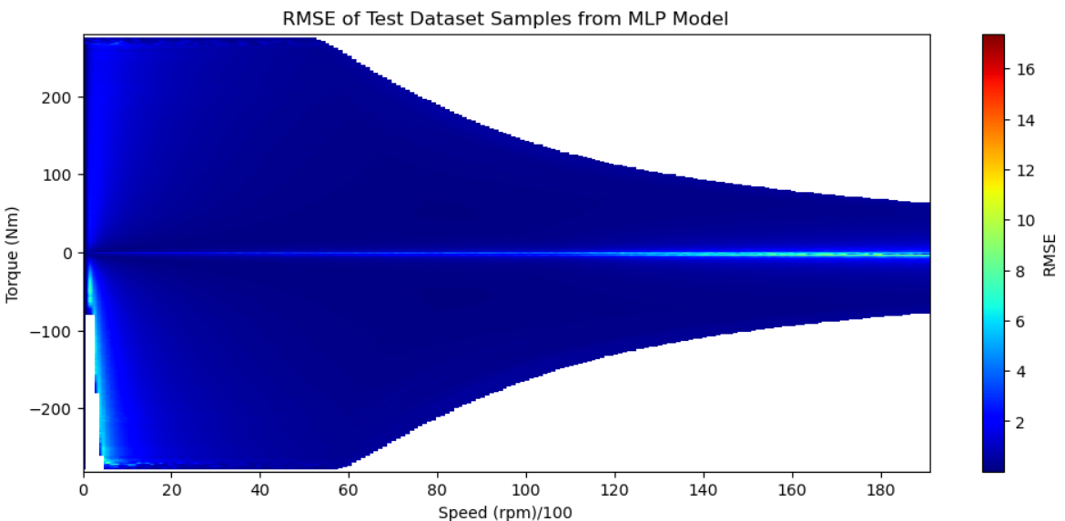
Evaluation Statistics 3D KPI

Slide 41
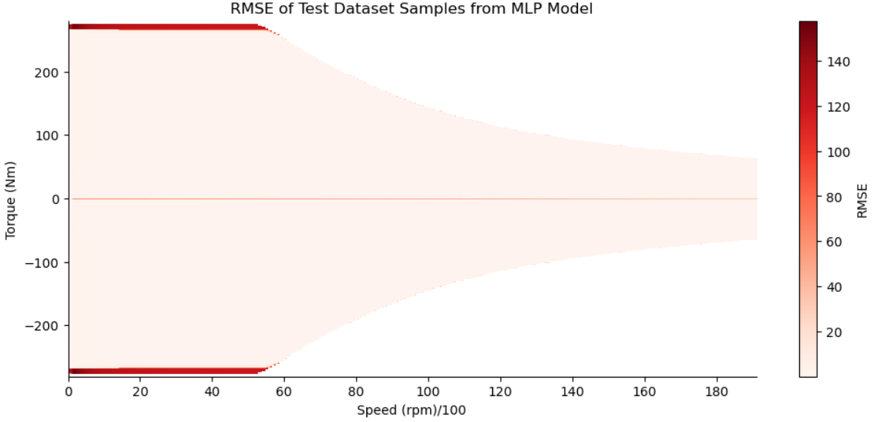
3D KPI(After mirroring ETAs)

Slide 42
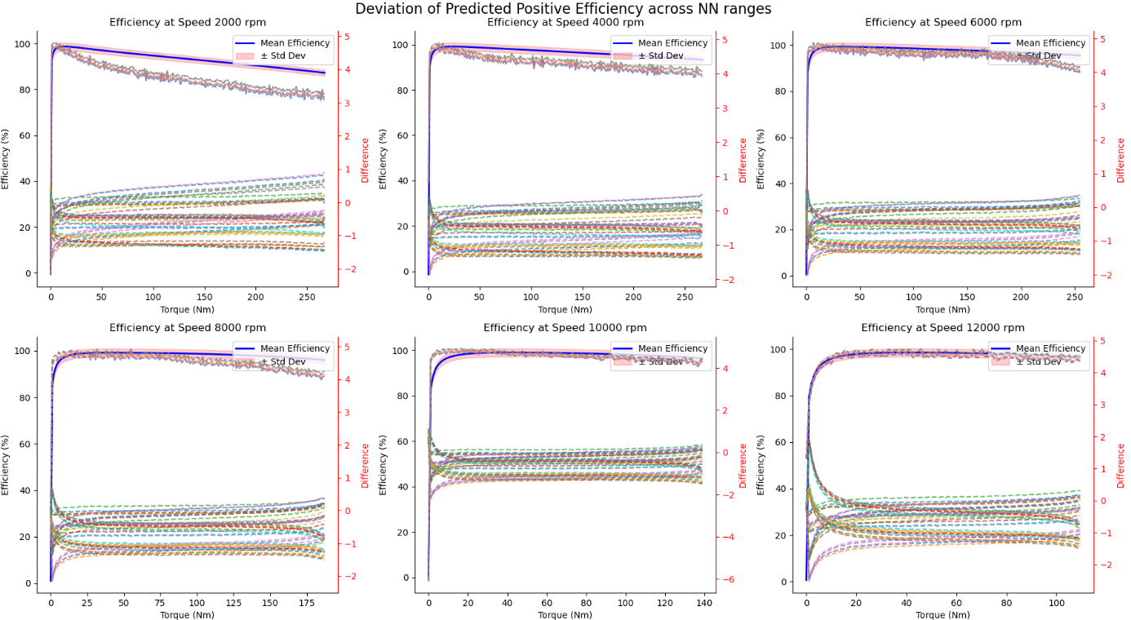
3D KPI(After mirroring ETAs)

Slide 43
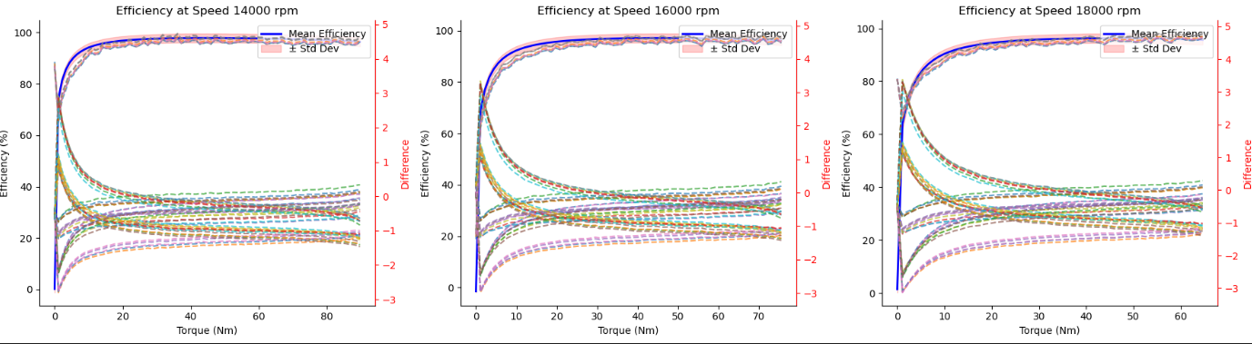
3D KPI(After mirroring ETAs)

Slide 44
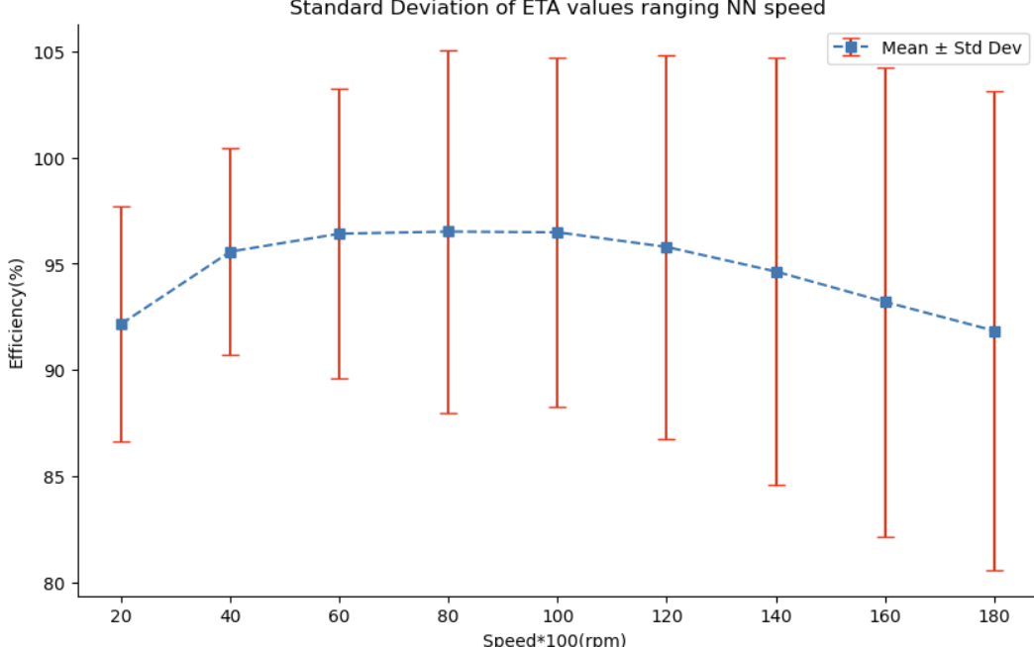
3D KPI(After mirroring ETAs)

Slide 45
Baseline Model
Averaged Test Dataset for both outputs

Slide 46
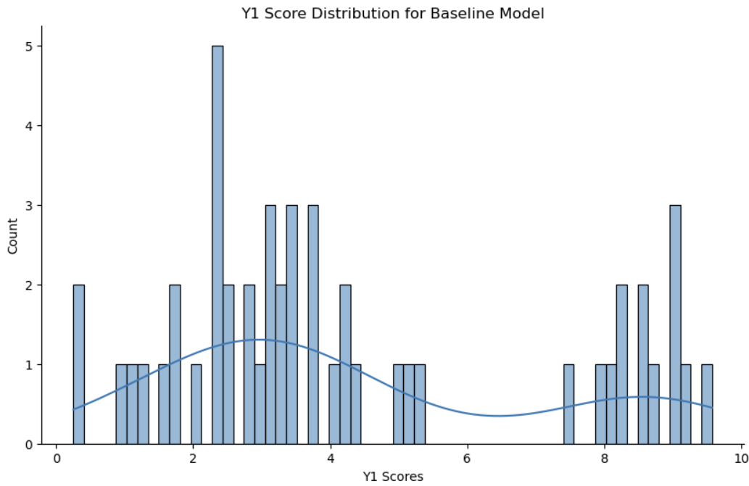
2D KPI

Slide 47
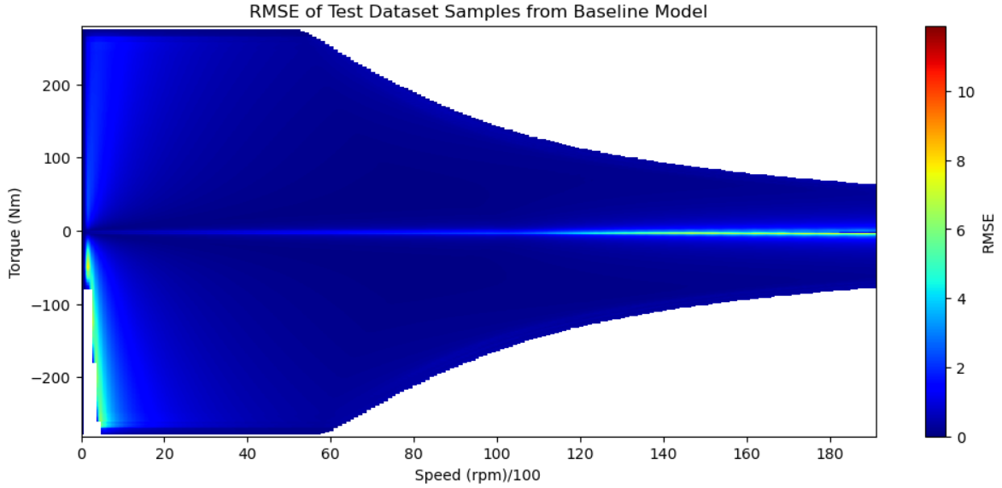
3D KPI

Slide 48
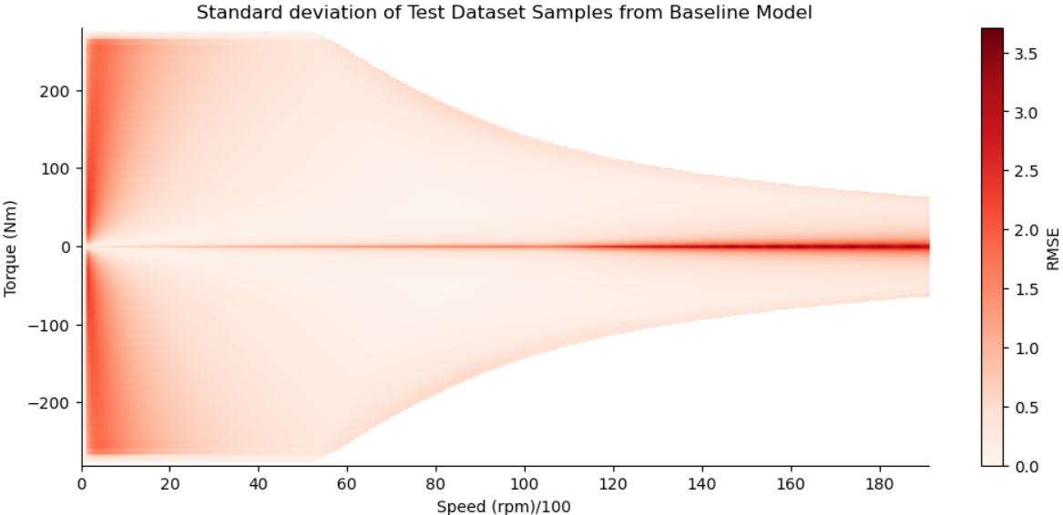
3D KPI(After mirroring ETAs)

Slide 49
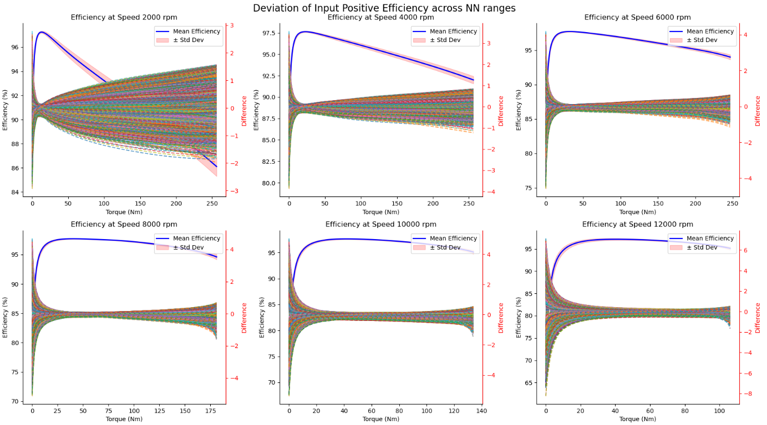
3D KPI(After mirroring ETAs)

Slide 50
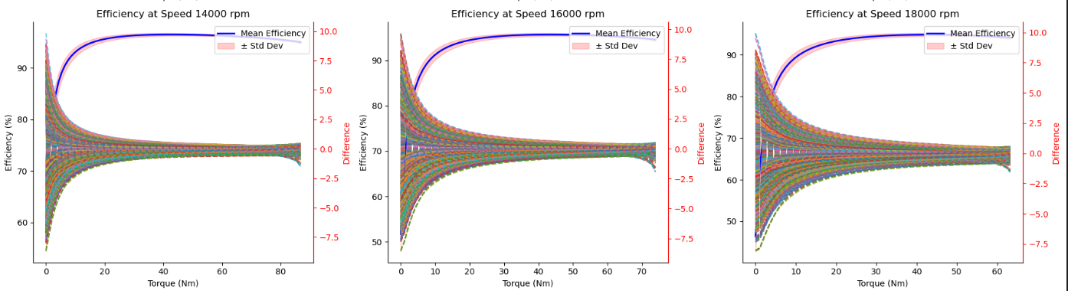
3D KPI(After mirroring ETAs)

Slide 51
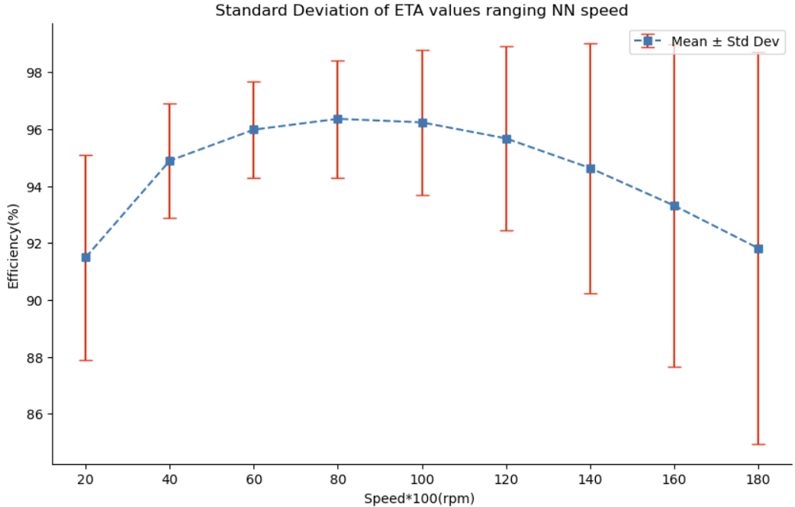
3D KPI(After mirroring ETAs)

Slide 52
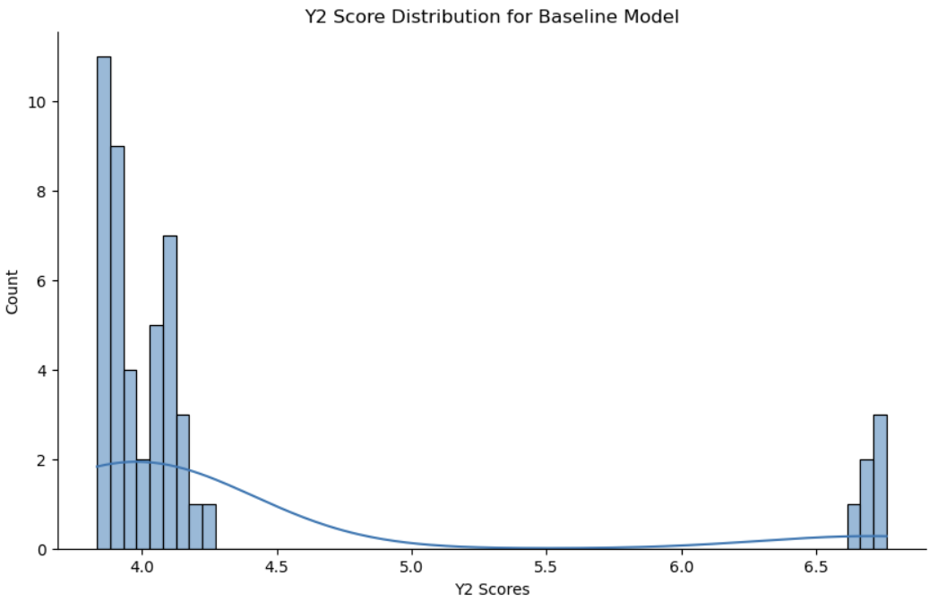
3D KPI(After mirroring ETAs)

Slide 53
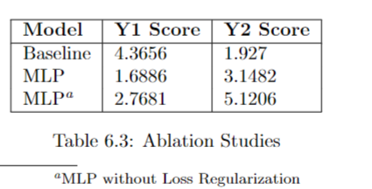

Ablation Studies

Slide 54
2nd Approach

Slide 55
GNN
GNNs aim to learn a representation vector for each node after L layer transformations based on graph structure and initial node feature
Representation of each node is computed by recursively aggregating features of neighbour nodes
These relations can be composited with each other to learn high level semantic relations - Metapaths

Slide 56

GNN
2 types :
Homogeneous GNN
Heterogeneous GNN

Slide 57
Purposes
Node Prediction
Edge Prediction
Graph Prediction

Slide 58
Applications
Recommendation Networks
Academic Networks
Information Networks
Social Networks
Generally involves 1 giant graph - hence the importance of going graph batch, splits etc.
Our use case : 1 graph per EM variant

Slide 59
Graph Representation
2 types :
Metapath based HGNN
Capture structural info of same semantic and then fuse diff semantic info
Metapath Free based HGNN
Capture structural and semantic information simultaneously

Slide 60

Message Passing

Slide 61
Homogeneous GNN Message Passing
As node and edge are of same type.
MP is done over neighbouring nodes and edges over hops until it learns a representation equivalent from its neighbours

Slide 62
Heterogeneous GNN Message Passing
Node & Edge features from different types cannot be processed by same function due to difference in feature type and / or dimensionality
Therefore MP functions need to be implemented individually for each edge type.
MP GNN algorithm need to iterate over edge type dictionaries during message computation and over node type dictionaries during node updates

Slide 63
OverSmoothing & Gradient Vanishing
GNNs cannot be too deep due to oversmoothing problem.
Impedes model training by isolating output representations from the input features with increase in depth
Mitigate by including pre activation residual connections

Slide 64
Graph Representation
Using Hetereogeneous GNN model
Represent data as graph - networkx graph
Topology invariance to be achieved here by having different nodes and edges but node and edge type always would remain consistent
Geometry is much better represented
Multiple slots/Magnets/Windings are represented as different nodes
Apt for our usecase

Slide 65
Double V Magnet Topology
Node Types
{v, vm, r, s, sw}
Edge Types
{a, d1, d2, d4}

Slide 66


Slide 67
Scaling
Standard Scaling for each node type and edge type

Slide 68
Mapping
Node Mapping
Edge Mapping

Slide 69
Modelling
Linear Layer for each Node type
Convolutional layer for each edge type
Presumably another Linear layer for each Edge feature

Slide 70
Thank you

